Slide 1
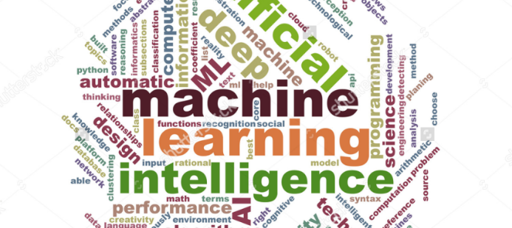
Pembelajaran Mesin
Dr. Retno Kusumaningrum, S.Si., M.Kom.
Notes:
Alasan Libur 2 Minggu Pertama
3 Investasi Utama Hidup

Slide 2
The Course
Academic Year 2018/2019

Slide 3
About the Course
Mata Kuliah : Pembelajaran Mesin
Machine Learning
Kode Mata Kuliah : AIK21356
Dosen Pengampu :
Pre Mid Term
Dr. Retno Kusumaningrum, S.Si., M.Kom
Post Mid Term
Khadijah, S.Kom., M.Cs.
Semester V

Slide 4
Assessment
Komponen Penilaian :
Tugas : 30%
UTS : 35%
UAS : 35%
Rentang Nilai :
A : 80 – 100
B : 60 – 79
C : 40 – 59
D : 20 – 39
E : <20

Slide 5
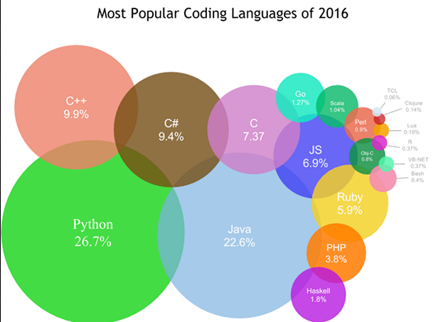
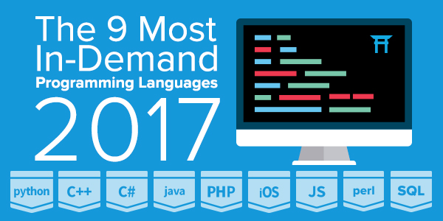
Praktikum?
Source: Code Dojo
Source: Code Eval
Notes:
Tergantung Doa Dari Anda

Slide 6
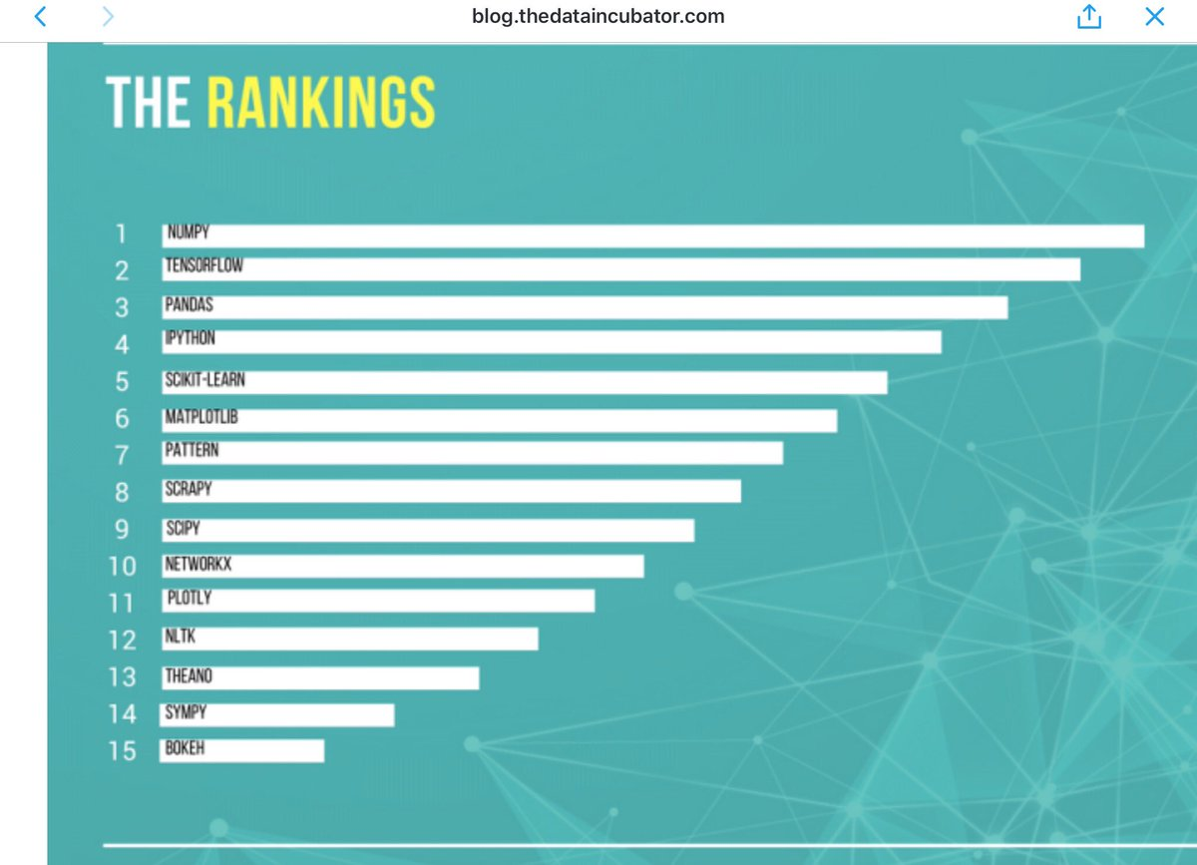

Slide 7
Know The Rules!
Berpakaian rapi, sopan, dan memakai sepatu
Tidur di Kelas akan dikeluarkan dari kelas
No Plagiarism
Toleransi keterlambatan menit
Kormat Kelas B :
Kormat Kelas A :

Slide 8
Materi

Slide 9
References
Christoper M. Bishop, Pattern Recognition and Machine Learning, Springer, 2006
Trevor Hastie, Robert Tibshirani and Jerome Friedman, Elements of Statistical Learning (2nd Edition), Springer Verlag, 2009
David MacKay, Information Theory, Inference, and Learning Algorithms (ver. 7.2), Cambridge University Press, 2005
David Barber, Bayesian Reasoning and Machine Learning, Cambridge University Press, 2016
Artikel-artikel Ilmiah

Slide 10
Pembelajaran Mesin
Di Informatika UNDIP

Slide 11
Machine Learning From Zero to Hero
Kurikulum 2012 :
Machine Learning
Mata Kuliah Pilihan
Peserta Per Kelas : ± 10
Kurikulum 2017
Pembelajaran Mesin ≈ Machine Learning
Mata Kuliah Wajib

Slide 12
Why?
Machine Learning can be implemented in various fields:
Software Engineering
Information System & Information Technology
Computation and Graphics
Intelligent System

Slide 13
What is Machine Learning?
Definition and Its History

Slide 14
Learning from Data
World is Driven by Data
Germany’s climate research center generates 10 petabytes per year
Google processes 24 petabytes per day
There are over 50m credit card transactions a day in the US alone
etc

Slide 15
Learning from Data
Data is recorded from some real phenomenon
What might we want to do with that data?
Prediction
what can we predict about this phenomenon?
Description
how can we describe/understand this phenomenon in a new way?

Slide 16
Learning from Data
How can we extract knowledge from data to help humans take decisions?
1
How can we automate decisions from data?
2
How can we adapt systems dynamically to enable better user experiences?
3

Slide 17
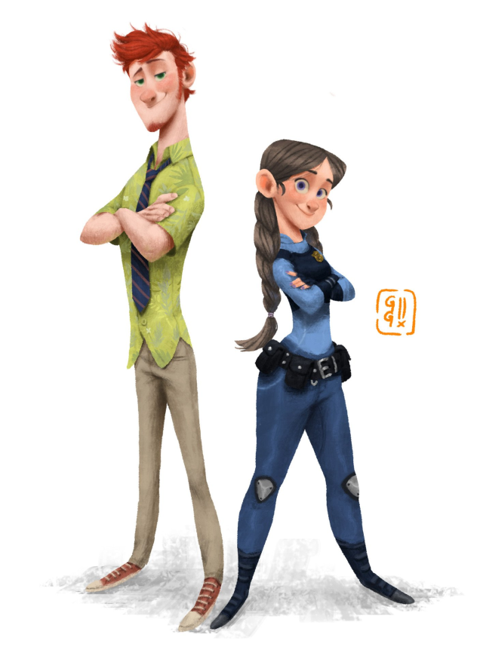


Machine Learning
data
Learn from Experience
Learn from Experience
Follow Instructions
Computer
Computer
Human

Slide 18
What is Machine Learning?
Subfield of Artificial Intelligence
Name is derived from the concept that it deals with “construction and study of systems that can learn from data”
Can be seen as building blocks to make computers learns to behave more intelligently
It is a theoretical concept . There are various techniques with various implementations

Slide 19
Learning and Solution Components
Definition, Formalization, and Its Samples
Notes:
Kenapa harus mengetahui komponen pembelajaran dan solusi pembelajaran:
Jangan sampai kita menyelesaikan sesuatu dengan algoritma machine learning yang cukup rumit tetapi sebenarnya cukup dengan rumus matematika yang sangat sederhana
Contohnya: seseorang lapar ingin makan dengan ayam goreng ➔ cukup disajikan ayam goreng tepung, ayam goreng jawa. Tetapi kita sajikan cheesy chicken KFC. Jadi sesuatu yang berlebihan.
Contoh Lain: Untuk mengetahui apakah mahasiswa yang diterima di prodi matematika itu memang menyukai matematika dan/atau memilih prodi terkait pada saat SNMPTN, SBMPTN, ataupun UM

Slide 20
Component of Learning
Contoh : credit approval
Bank tidak memiliki magic formula untuk menentukan apakah seseorang tepat untuk diberikan kredit / tidak?
Data historis kreditur bank dan bagaimana perilaku kreditur tersebut

Slide 21
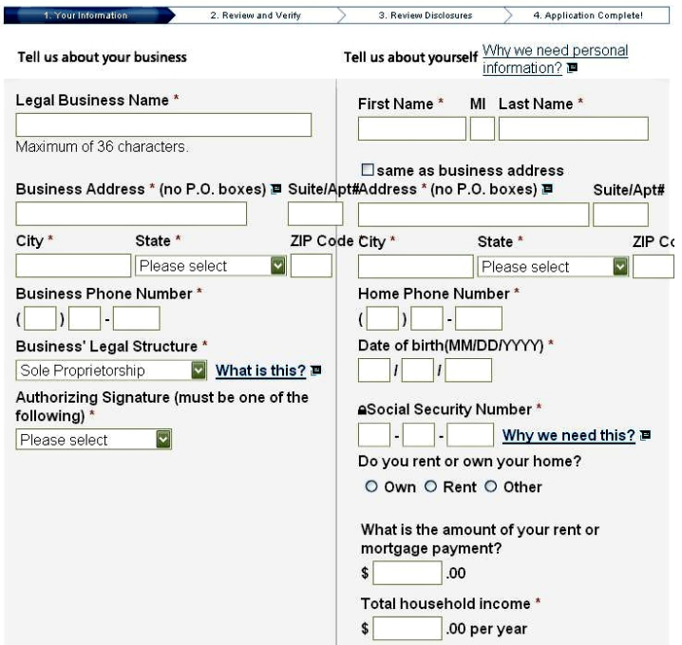

Slide 22
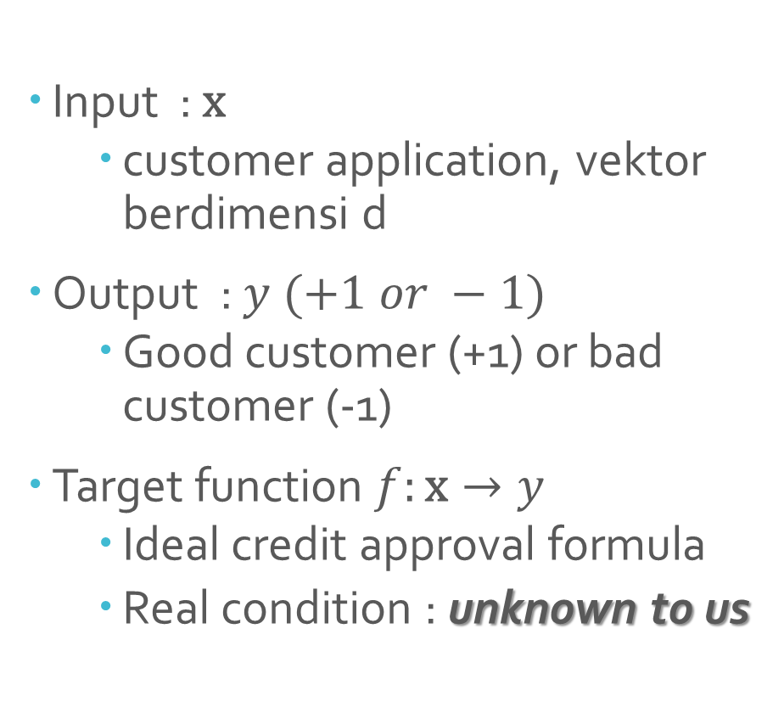
Formalization
Input : $\text{x}$
customer application, vektor berdimensi d
Output : $y (+1 or −1)$
Good customer (+1) or bad customer (-1)
Target function $f:\text{x}→y$
Ideal credit approval formula
Real condition : unknown to us

Slide 23
Why target function is unknown to us?
Jika kita sudah tahu apa target function-nya maka yang bisa kita lakukan adalah cukup menerapkan rumusnya dan dihitung secara matematis…selesai…
Therefore, we need to learn from data

Slide 24
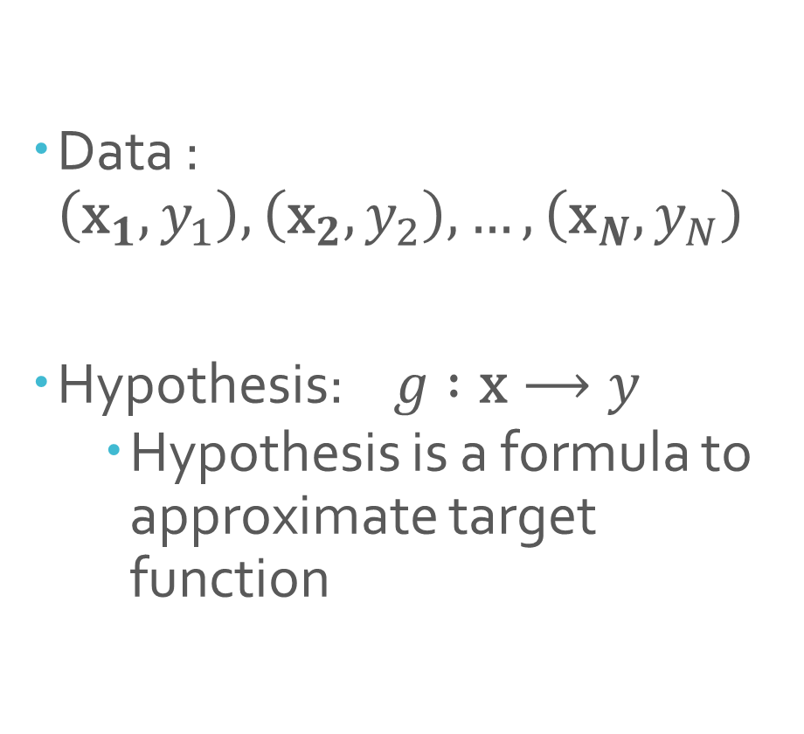
Data : $\left({\text{x}}_{1},y_{1}\right),\left({\text{x}}_{2},y_{2}\right), …, \left({\text{x}}_{N},y_{N}\right)$
Hypothesis: $g :\text{x}⟶y$
Hypothesis is a formula to approximate target function

Slide 25
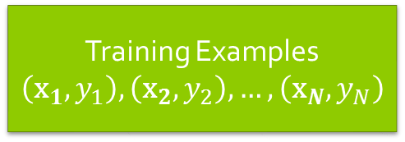
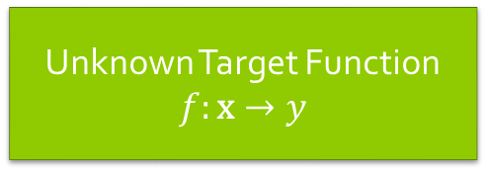


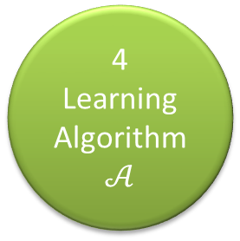
1
Unknown Target Function
$$f:\text{x}→y$$
Ideal credit approval function
2
Training Examples
$$\left({\text{x}}_{1},y_{1}\right),\left({\text{x}}_{2},y_{2}\right), …, \left({\text{x}}_{N},y_{N}\right)$$
Historical records of credit customers
4
Learning Algorithm
$$𝒜$$
3
Final Hypothesis
$$g≈f$$
5
Final credit approval formula
Hypothesis Set
$$ℋ$$
A set of candidate formulas

Slide 26
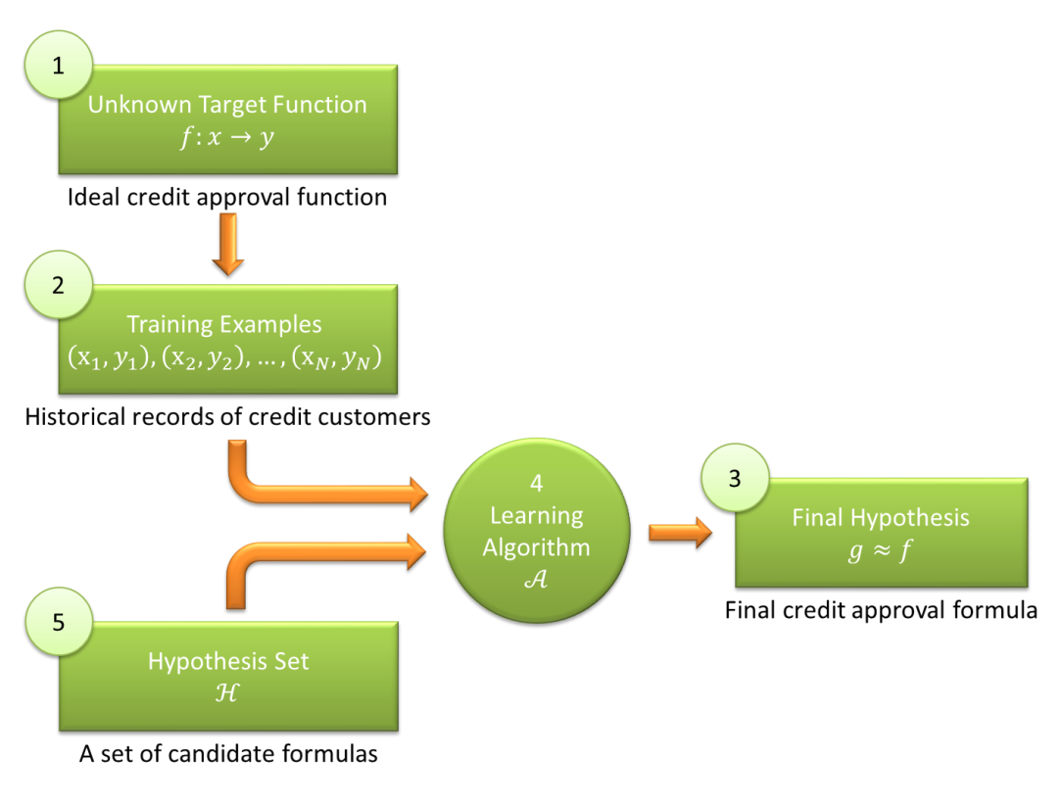
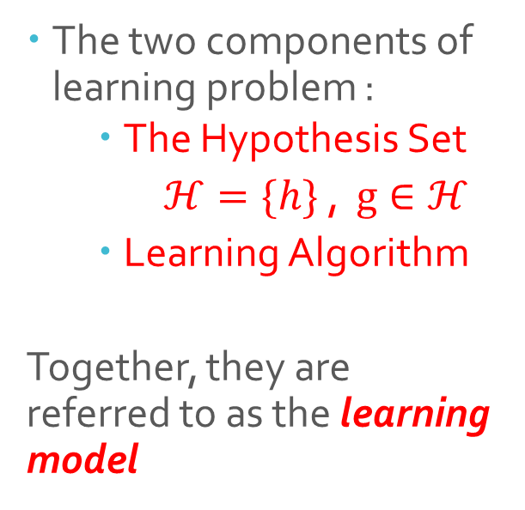
Solution Components
The two components of learning problem :
The Hypothesis Set
$ℋ=\{h\}$ , $g∈ℋ$
Learning Algorithm
Together, they are referred to as the learning model

Slide 27
Conclusions
Learning is used when ……………
We have data on it
We cannot pin it down mathematically
A pattern exists

Slide 28
Learning Methods
Three Types

Slide 29
LEARNING METHODS
Supervised Learning
Unsupervised Learning
Reinforcement Learning

Slide 30
SUPERVISED LEARNING
Structure

Slide 31
Training Process
Machine Learning Algorithm
Feature Vector
Labeled Data
Classification Model
Testing Process
Classify / Predict
Expected Label / Class
Feature Vector
New Data

Slide 32
Algorithm
K-Nearest Neighboor
1
Decision Tree
2
Support Vector Machine (SVM)
3
Bayesian Learning includes Naive Bayes
4

Slide 33
Unsupervised Learning
Illustration

Slide 34
Illustration
Sample
Text
Sample
Text
Sample
Text
Sample
Text
Text
Text
Sample
Text
Text
Sample
Text
Sample
Text
Text
Sample
Text
Sample
Text
Text
Sample
Text
Text
Text
Text
Text
Sample
Text
Sample
Text
Sample
Text
Find “natural” grouping of instances given un-labeled data

Slide 35
identifying a finite set of categories or clusters to describe the data.
1st Cluster
Text
Sample
Text
Sample
Text
Sample
Text
Sample
Text
Text
Sample
Text
Text
Sample
Text
Text
Text
Sample
Text
Sample
Text
Text
Sample
Text
Sample
Text
Sample
Text
Text
Sample
Text
Sample
Text
2nd Cluster
Text
Text

Slide 36
Algorithm
K-Means Clustering
1
Hiearar-chical Clustering
2
Self Organizing Maps
3

Slide 37
Reinforcement Learning
In Brief
Notes:
Contoh permainan Catur
Ada rewards dan ada punishment

Slide 38
Implementation Approach of Machine Learning Methods
Two Approaches

Slide 39
Batch Learning
Online Learning
1
2

Slide 40
Machine Learning In Everywhere
Example

Slide 41
Machine Learning
in Software Engineering

Slide 42
Software quality (high-risk, or fault-prone component identification)
Software Defect Detection
Software Reliability
etc.
Series on Software Engineering and Knowledge Engineering: Volume 16
Machine Learning Applications in Software Engineering
Edited by: Du Zhang (California State University, USA), Jeffrey J P Tsai (University of Illinois, Chicago,USA)
Feb 2005

Slide 43
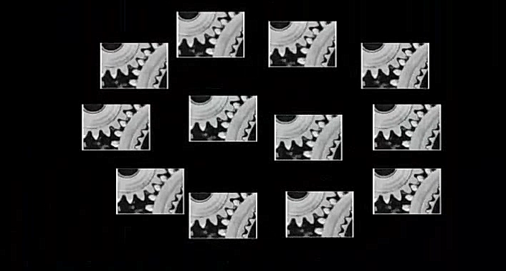
Software Defect Detection using Machine Learning
Software Code Is Composed of Several Components

Slide 44
Software Defect Detection using Machine Learning
Testing all these components can be very expensive

Slide 45
Software Defect Detection using Machine Learning
If we know which components are likely to be defective, we can increase testing cost-effectiveness

Slide 46
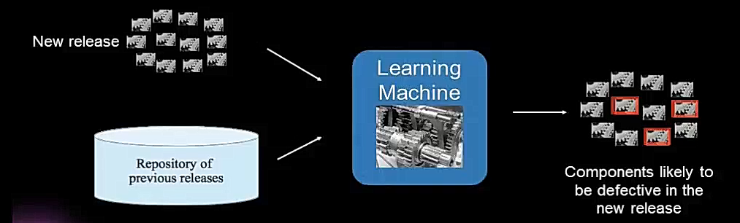
Software Defect Detection using Machine Learning
Predictive model can be created to identify components likely to be defective by using past software releases and bug fixes as training data for machine learning

Slide 47

Software Defect Detection using Machine Learning
Notes:
Pertanyaan pertama : Supervised Learning atau Unsupervised Learning
Lihat corat-coret => components
Input
Output
Target Function
Data
Hypothesis Set
Tujuan
Data : Training Data dan Testing Data, bagaimana komposisinya, bagaimana memperolehnya, bagaimana membedakannya

Slide 48
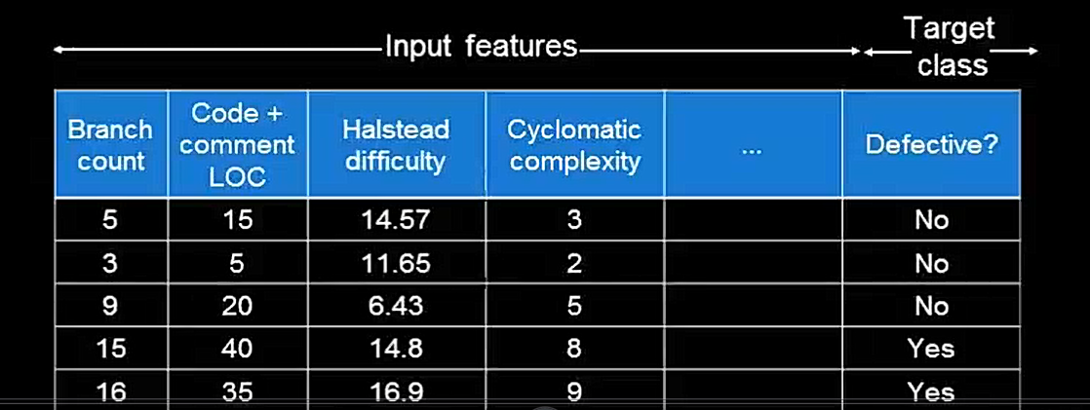
Software Defect Detection using Machine Learning
Notes:
Pertanyaan pertama : Supervised Learning atau Unsupervised Learning
Lihat corat-coret => components
Input
Output
Target Function
Data
Hypothesis Set
Tujuan
Data : Training Data dan Testing Data, bagaimana komposisinya, bagaimana memperolehnya, bagaimana membedakannya

Slide 49
Machine Learning
in Information System & Information Technology

Slide 50
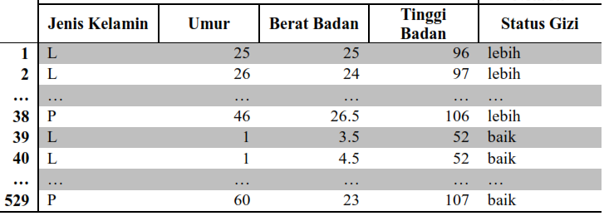
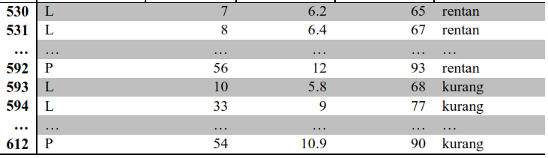

Slide 51
Machine Learning
in Computation and Graphics

Slide 52
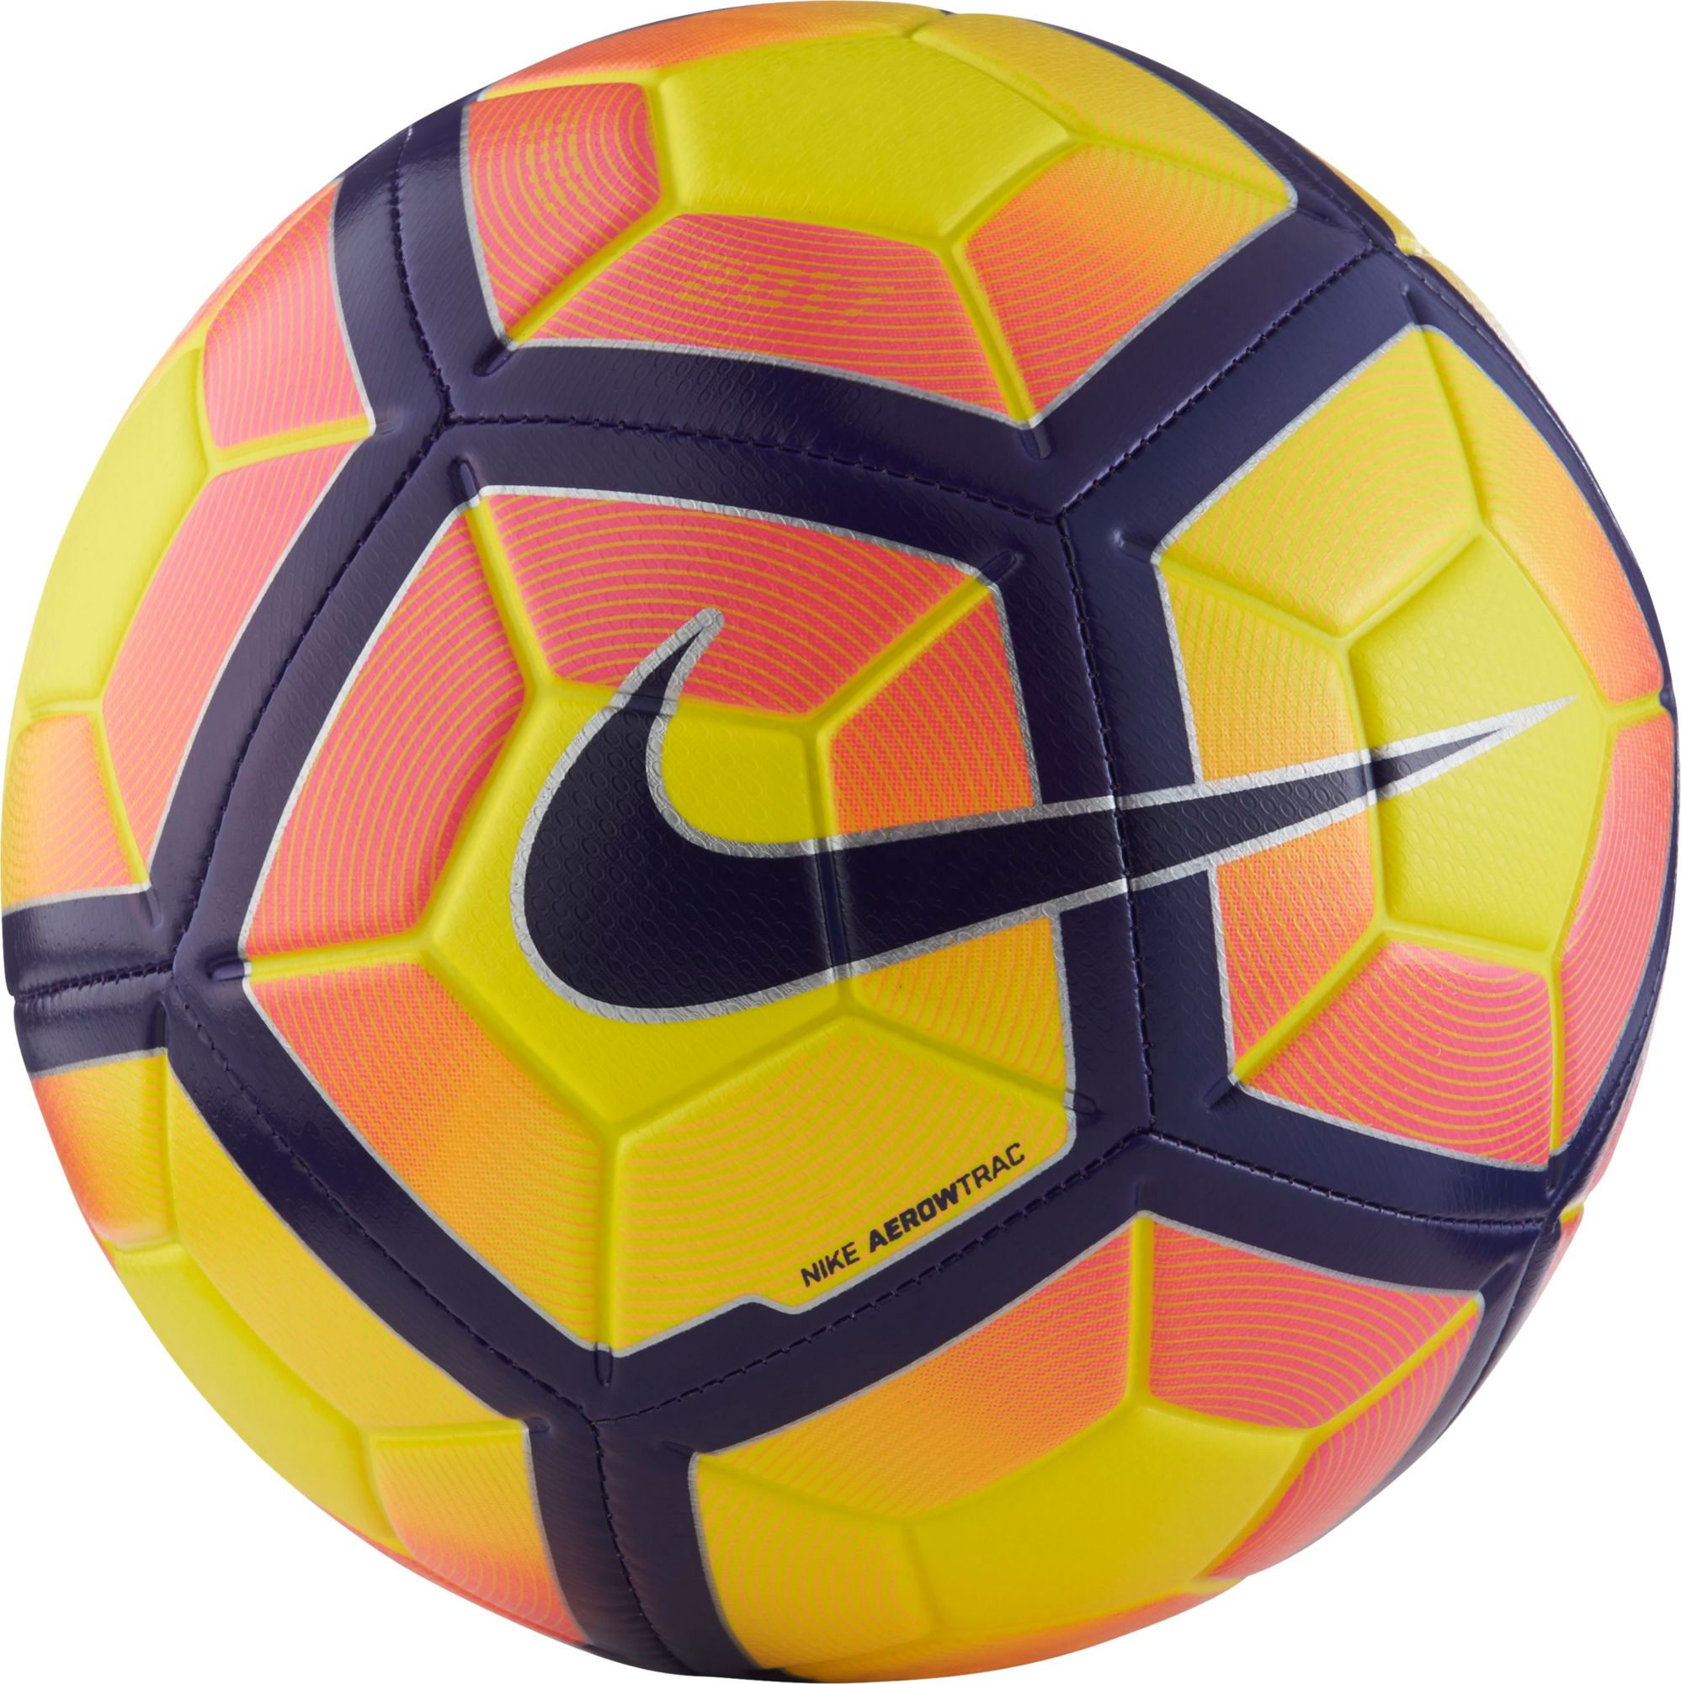

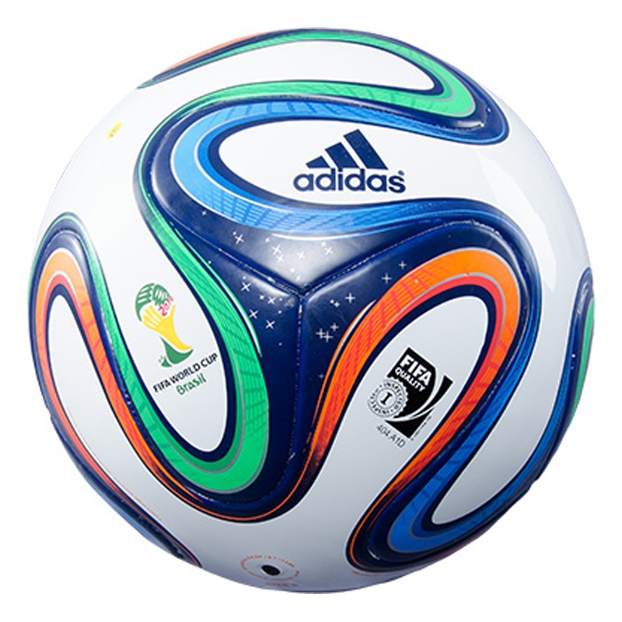





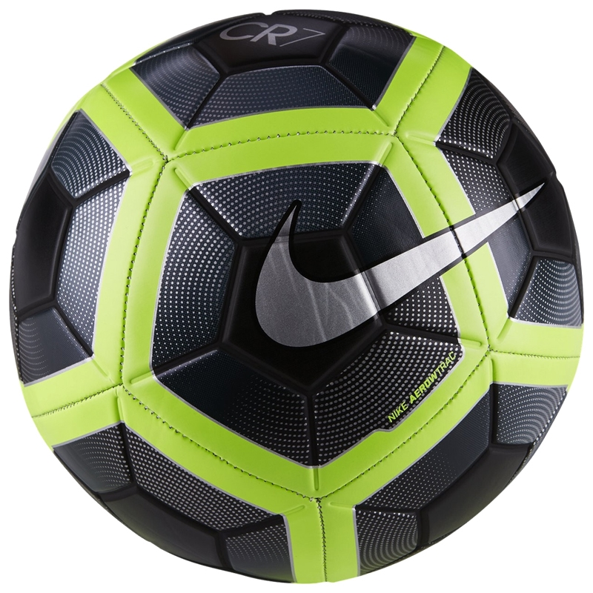

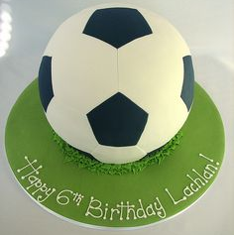
How to Predict New Ball Pictures?
Tennis Ball
Soccer Ball

Slide 53

Sollutions ?????
What is The Method?
Supervised
Unsupervised
What is/are The Feature(s)?
Color?
Shape?
Size?
Texture?
Or .... ?
What is/are The Algorithm(s)?

Slide 54
Machine Learning
in Intelligent System

Slide 55
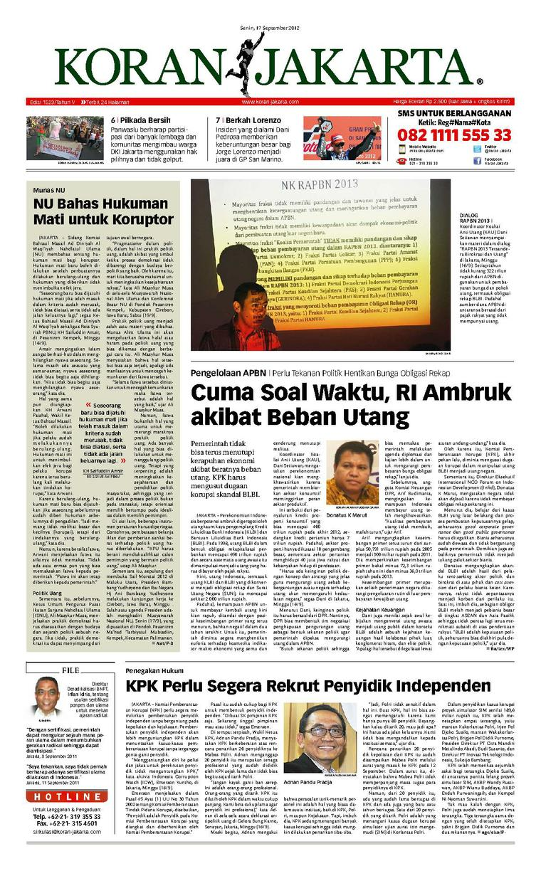
News Docu-ments
Politics
Sport
Enter-tainment
Eco-nomy
Culture
Crimi-nal

Slide 56
Sollutions ?????
What is The Method?
Supervised
Unsupervised
What is/are The Feature(s)?
TF-IDF
N-Grams (Unigram, Bigram, Trigram, Quadgram, etc)
What is/are The Algorithm(s)?
PoS

